Slide 1
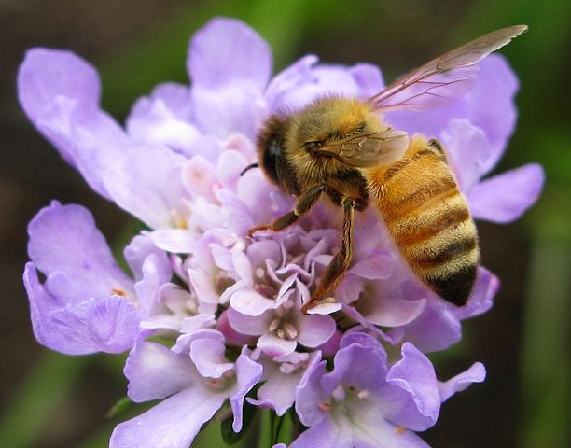
Creation: Bible and Science
CC SA BY 3.0
http://www.forestwander.com/
Notes:
https://commons.wikimedia.org/wiki/File:Bee-Purple-Flower-Macro_ForestWander.jpg
Creative Commons Attribution-Share Alike 3.0 United States, attributed to ForestWander, http://www.forestwander.com/.
Unless otherwise indicated, all English Scripture quotations are from the ESV® Bible (The Holy Bible, English Standard Version®), copyright © 2001 by Crossway, a publishing ministry of Good News Publishers. Used by permission. All rights reserved.

Slide 2
Unless otherwise indicated, all English Scripture quotations are from the ESV® Bible (The Holy Bible, English Standard Version®), copyright © 2001 by Crossway, a publishing ministry of Good News Publishers. Used by permission. All rights reserved.

Slide 3
Copyright Specifications
Copyright (c) 2006 Vern S. Poythress.
Permission is granted to copy, distribute and/or modify this document under the terms of the GNU Free Documentation License, Version 1.2 or any later version published by the Free Software Foundation; with no Invariant Sections, no Front-Cover Texts, and no Back-Cover Texts. A copy of the license is included in the next slides and at
<http://www.fsf.org/licensing/licenses/fdl.html>.
The clipart embedded within the slides is from various sources, primarily from MS Office clipart gallery, Corel Clip-Art from CD-ROM Clipart, Symbols & Flics, which was part of Corel Draw 3.0, and Corel Megagallery, which came with Corel Draw 8. I have tried to make sure that the clipart can be freely copied and modified, but it is not itself subject to the GNU Free Documentation License. Likewise photos are from various sources, primarily Corel Megagallery. Except when the photos are my own, they are not subject to the GNU Free Documentation License.

Slide 4
GNU Free Documentation License
Version 1.2, November 2002
Copyright (C) 2000,2001,2002 Free Software Foundation, Inc.
51 Franklin Street, Fifth Floor, Boston, MA 02110-1301, USA
Everyone is permitted to copy and distribute verbatim copies
of this license document, but changing it is not allowed.
0. PREAMBLE
The purpose of this License is to make a manual, textbook, or other functional and useful document "free" in the sense of freedom: to assure everyone the effective freedom to copy and redistribute it, with or without modifying it, either commercially or noncommercially. Secondarily, this License preserves for the author and publisher a way to get credit for their work, while not being considered responsible for modifications made by others.
This License is a kind of "copyleft", which means that derivative works of the document must themselves be free in the same sense. It complements the GNU General Public License, which is a copyleft license designed for free software.
We have designed this License in order to use it for manuals for free software, because free software needs free documentation: a free program should come with manuals providing the same freedoms that the software does. But this License is not limited to software manuals; it can be used for any textual work, regardless of subject matter or whether it is published as a printed book. We recommend this License principally for works whose purpose is instruction or reference.
1. APPLICABILITY AND DEFINITIONS
This License applies to any manual or other work, in any medium, that contains a notice placed by the copyright holder saying it can be distributed under the terms of this License. Such a notice grants a world-wide, royalty-free license, unlimited in duration, to use that work under the conditions stated herein. The "Document", below, refers to any such manual or work. Any member of the public is a licensee, and is addressed as "you". You accept the license if you copy, modify or distribute the work in a way requiring permission under copyright law.
A "Modified Version" of the Document means any work containing the Document or a portion of it, either copied verbatim, or with modifications and/or translated into another language.
A "Secondary Section" is a named appendix or a front-matter section of the Document that deals exclusively with the relationship of the publishers or authors of the Document to the Document's overall subject (or to related matters) and contains nothing that could fall directly within that overall subject. (Thus, if the Document is in part a textbook of mathematics, a Secondary Section may not explain any mathematics.) The relationship could be a matter of historical connection with the subject or with related matters, or of legal, commercial, philosophical, ethical or political position regarding them.

Slide 5
The "Invariant Sections" are certain Secondary Sections whose titles are designated, as being those of Invariant Sections, in the notice that says that the Document is released under this License. If a section does not fit the above definition of Secondary then it is not allowed to be designated as Invariant. The Document may contain zero Invariant Sections. If the Document does not identify any Invariant Sections then there are none.
The "Cover Texts" are certain short passages of text that are listed, as Front-Cover Texts or Back-Cover Texts, in the notice that says that the Document is released under this License. A Front-Cover Text may be at most 5 words, and a Back-Cover Text may be at most 25 words.
A "Transparent" copy of the Document means a machine-readable copy, represented in a format whose specification is available to the general public, that is suitable for revising the document straightforwardly with generic text editors or (for images composed of pixels) generic paint programs or (for drawings) some widely available drawing editor, and that is suitable for input to text formatters or for automatic translation to a variety of formats suitable for input to text formatters. A copy made in an otherwise Transparent file format whose markup, or absence of markup, has been arranged to thwart or discourage subsequent modification by readers is not Transparent. An image format is not Transparent if used for any substantial amount of text. A copy that is not "Transparent" is called "Opaque".
Examples of suitable formats for Transparent copies include plain ASCII without markup, Texinfo input format, LaTeX input format, SGML or XML using a publicly available DTD, and standard-conforming simple HTML, PostScript or PDF designed for human modification. Examples of transparent image formats include PNG, XCF and JPG. Opaque formats include proprietary formats that can be read and edited only by proprietary word processors, SGML or XML for which the DTD and/or processing tools are not generally available, and the machine-generated HTML, PostScript or PDF produced by some word processors for output purposes only.
The "Title Page" means, for a printed book, the title page itself, plus such following pages as are needed to hold, legibly, the material this License requires to appear in the title page. For works in formats which do not have any title page as such, "Title Page" means the text near the most prominent appearance of the work's title, preceding the beginning of the body of the text.
A section "Entitled XYZ" means a named subunit of the Document whose title either is precisely XYZ or contains XYZ in parentheses following text that translates XYZ in another language. (Here XYZ stands for a specific section name mentioned below, such as "Acknowledgements", "Dedications", "Endorsements", or "History".) To "Preserve the Title" of such a section when you modify the Document means that it remains a section "Entitled XYZ" according to this definition.
The Document may include Warranty Disclaimers next to the notice which states that this License applies to the Document. These Warranty Disclaimers are considered to be included by reference in this License, but only as regards disclaiming warranties: any other implication that these Warranty Disclaimers may have is void and has no effect on the meaning of this License.
2. VERBATIM COPYING
You may copy and distribute the Document in any medium, either commercially or noncommercially, provided that this License, the copyright notices, and the license notice saying this License applies to the Document are reproduced in all copies, and that you add no other conditions whatsoever to those of this License. You may not use technical measures to obstruct or control the reading or further copying of the copies you make or distribute. However, you may accept compensation in exchange for copies. If you distribute a large enough number of copies you must also follow the conditions in section 3.
You may also lend copies, under the same conditions stated above, and you may publicly display copies.

Slide 6
3. COPYING IN QUANTITY
If you publish printed copies (or copies in media that commonly have printed covers) of the Document, numbering more than 100, and the Document's license notice requires Cover Texts, you must enclose the copies in covers that carry, clearly and legibly, all these Cover Texts: Front-Cover Texts on the front cover, and Back-Cover Texts on the back cover. Both covers must also clearly and legibly identify you as the publisher of these copies. The front cover must present the full title with all words of the title equally prominent and visible. You may add other material on the covers in addition. Copying with changes limited to the covers, as long as they preserve the title of the Document and satisfy these conditions, can be treated as verbatim copying in other respects.
If the required texts for either cover are too voluminous to fit legibly, you should put the first ones listed (as many as fit reasonably) on the actual cover, and continue the rest onto adjacent pages.
If you publish or distribute Opaque copies of the Document numbering more than 100, you must either include a machine-readable Transparent copy along with each Opaque copy, or state in or with each Opaque copy a computer-network location from which the general network-using public has access to download using public-standard network protocols a complete Transparent copy of the Document, free of added material. If you use the latter option, you must take reasonably prudent steps, when you begin distribution of Opaque copies in quantity, to ensure that this Transparent copy will remain thus accessible at the stated location until at least one year after the last time you distribute an Opaque copy (directly or through your agents or retailers) of that edition to the public.
It is requested, but not required, that you contact the authors of the Document well before redistributing any large number of copies, to give them a chance to provide you with an updated version of the Document.
4. MODIFICATIONS
You may copy and distribute a Modified Version of the Document under the conditions of sections 2 and 3 above, provided that you release the Modified Version under precisely this License, with the Modified Version filling the role of the Document, thus licensing distribution and modification of the Modified Version to whoever possesses a copy of it. In addition, you must do these things in the Modified Version:
* A. Use in the Title Page (and on the covers, if any) a title distinct from that of the Document, and from those of previous versions (which should, if there were any, be listed in the History section of the Document). You may use the same title as a previous version if the original publisher of that version gives permission.
* B. List on the Title Page, as authors, one or more persons or entities responsible for authorship of the modifications in the Modified Version, together with at least five of the principal authors of the Document (all of its principal authors, if it has fewer than five), unless they release you from this requirement.
* C. State on the Title page the name of the publisher of the Modified Version, as the publisher.
* D. Preserve all the copyright notices of the Document.
* E. Add an appropriate copyright notice for your modifications adjacent to the other copyright notices.

Slide 7
* F. Include, immediately after the copyright notices, a license notice giving the public permission to use the Modified Version under the terms of this License, in the form shown in the Addendum below.
* G. Preserve in that license notice the full lists of Invariant Sections and required Cover Texts given in the Document's license notice.
* H. Include an unaltered copy of this License.
* I. Preserve the section Entitled "History", Preserve its Title, and add to it an item stating at least the title, year, new authors, and publisher of the Modified Version as given on the Title Page. If there is no section Entitled "History" in the Document, create one stating the title, year, authors, and publisher of the Document as given on its Title Page, then add an item describing the Modified Version as stated in the previous sentence.
* J. Preserve the network location, if any, given in the Document for public access to a Transparent copy of the Document, and likewise the network locations given in the Document for previous versions it was based on. These may be placed in the "History" section. You may omit a network location for a work that was published at least four years before the Document itself, or if the original publisher of the version it refers to gives permission.
* K. For any section Entitled "Acknowledgements" or "Dedications", Preserve the Title of the section, and preserve in the section all the substance and tone of each of the contributor acknowledgements and/or dedications given therein.
* L. Preserve all the Invariant Sections of the Document, unaltered in their text and in their titles. Section numbers or the equivalent are not considered part of the section titles.
* M. Delete any section Entitled "Endorsements". Such a section may not be included in the Modified Version.
* N. Do not retitle any existing section to be Entitled "Endorsements" or to conflict in title with any Invariant Section.
* O. Preserve any Warranty Disclaimers.
If the Modified Version includes new front-matter sections or appendices that qualify as Secondary Sections and contain no material copied from the Document, you may at your option designate some or all of these sections as invariant. To do this, add their titles to the list of Invariant Sections in the Modified Version's license notice. These titles must be distinct from any other section titles.
You may add a section Entitled "Endorsements", provided it contains nothing but endorsements of your Modified Version by various parties--for example, statements of peer review or that the text has been approved by an organization as the authoritative definition of a standard.
You may add a passage of up to five words as a Front-Cover Text, and a passage of up to 25 words as a Back-Cover Text, to the end of the list of Cover Texts in the Modified Version. Only one passage of Front-Cover Text and one of Back-Cover Text may be added by (or through arrangements made by) any one entity. If the Document already includes a cover text for the same cover, previously added by you or by arrangement made by the same entity you are acting on behalf of, you may not add another; but you may replace the old one, on explicit permission from the previous publisher that added the old one.

Slide 8
The author(s) and publisher(s) of the Document do not by this License give permission to use their names for publicity for or to assert or imply endorsement of any Modified Version.
5. COMBINING DOCUMENTS
You may combine the Document with other documents released under this License, under the terms defined in section 4 above for modified versions, provided that you include in the combination all of the Invariant Sections of all of the original documents, unmodified, and list them all as Invariant Sections of your combined work in its license notice, and that you preserve all their Warranty Disclaimers.
The combined work need only contain one copy of this License, and multiple identical Invariant Sections may be replaced with a single copy. If there are multiple Invariant Sections with the same name but different contents, make the title of each such section unique by adding at the end of it, in parentheses, the name of the original author or publisher of that section if known, or else a unique number. Make the same adjustment to the section titles in the list of Invariant Sections in the license notice of the combined work.
In the combination, you must combine any sections Entitled "History" in the various original documents, forming one section Entitled "History"; likewise combine any sections Entitled "Acknowledgements", and any sections Entitled "Dedications". You must delete all sections Entitled "Endorsements."
6. COLLECTIONS OF DOCUMENTS
You may make a collection consisting of the Document and other documents released under this License, and replace the individual copies of this License in the various documents with a single copy that is included in the collection, provided that you follow the rules of this License for verbatim copying of each of the documents in all other respects.
You may extract a single document from such a collection, and distribute it individually under this License, provided you insert a copy of this License into the extracted document, and follow this License in all other respects regarding verbatim copying of that document.
7. AGGREGATION WITH INDEPENDENT WORKS
A compilation of the Document or its derivatives with other separate and independent documents or works, in or on a volume of a storage or distribution medium, is called an "aggregate" if the copyright resulting from the compilation is not used to limit the legal rights of the compilation's users beyond what the individual works permit. When the Document is included in an aggregate, this License does not apply to the other works in the aggregate which are not themselves derivative works of the Document.
If the Cover Text requirement of section 3 is applicable to these copies of the Document, then if the Document is less than one half of the entire aggregate, the Document's Cover Texts may be placed on covers that bracket the Document within the aggregate, or the electronic equivalent of covers if the Document is in electronic form. Otherwise they must appear on printed covers that bracket the whole aggregate.

Slide 9
A. Scientific Law
Principal views of scientific law

Slide 10
Scientific Law
By the word of the LORD the heavens were made,
and by the breath of his mouth all their host.
– Psalm 33:6
impersonalism
personalism
impersonal,
mechanistic
law
personal law,
fatherly
governance
Notes:
1
2

Slide 11
Worldviews on Miracle
impersonalism
personalism
matter, energy,
motion
God personally
created and rules
mechanism
personal purposes
no exceptions:
no miracles
exceptions: miracle
Notes:
1
2
3
5
4

Slide 12
Miracle of a Plague
Thus says the Lord, "By this you shall know that I am the Lord: behold, with the staff that is in my hand I will strike the water that is in the Nile, and it shall turn into blood." – Ex. 7:17

Slide 13
B. Age of the Earth
Principal theories, given that we are using a Christian worldview.

Slide 14
Simple Affirmation View
God created the world in six days, cycles of God's work and rest
Human beings imitate in a sabbath pattern (Exod. 20:8-11)
Days of creation are unique
So extrapolating from God's present providence involves guesswork
We might leave open how to fit in scientific claims
Notes:
*

Slide 15


Religious-Only Theory
The Bible tells why, not how. The Bible and science offer complementary descriptions, answering different questions.
Hence, there can be no contradiction.
How
Why
Neat, but
will it work?
CCO
MSFT gallery
CCO
Notes:
Microscope: https://pixabay.com/en/microscope-research-laboratory-311530/. Public Domain.
Bible: https://pixabay.com/p-1108074/?no_redirect. Public Domain.
*

Slide 16
Local Creation
Creation of whole universe
Gen. 1-2 is about
God’s acts in a local area
Eden
Notes:
1

Slide 17
The Gap Theory
Gen. 1:1
original act of creation
Gap: includes geologic ages
Gen. 1:2
judgment & ruin of original
Gen. 1:3-31
restoration from ruin in 6 days
1
2
3
4
5
6
Notes:
1
2
3
4

Slide 18
Revelatory Day Theory
1
2
3
4
5
6
On Moses’
4th day of
revelation Moses
hears from God
about the creation
of sun, moon, and stars.
Notes:
1

Slide 19
Evaluating Less Attractive Views
Religious-only
Local Creation
Gap Theory
Revelatory Day
Bible is factual.
Later allusions treat Gen. 1-2 as universal.
The Hebrew of 1:2 is circumstantial, not a narrative continuation.
No exegetical evidence.
Forget it.
Notes:
Religious-only is comfortable for scientists. But Bible makes factual claims.
Local Creation: it is theologically ridiculous for the primary narrative of creation to be thus restricted. It does not answer Israelite theological needs. And later Scripture treats it as universal.
*

Slide 20
Intermittent Day
24-hour days have gaps between them.
1
2
3
4
5
6
a geological age
God’s creative activity is spread out between
24-hour days, rather than occurring during them.
Notes:
1
2

Slide 21
Evaluating Intermittent Day
4
creative acts
Israelites working during six days, and rested on the seventh.
Exod. 20:11 leads to understanding God likewise. God works during days, not between them.
On this view, introducing six days rather than some other marker appears to have no other purpose but to form a pattern for man.
Hence, it is close to the framework view.
Notes:
*

Slide 22
Literal 24-Hour Days
1
2
3
4
5
6
Straight-
forward
24 hours long
Notes:
Often, combined with flood geology.
1

Slide 23
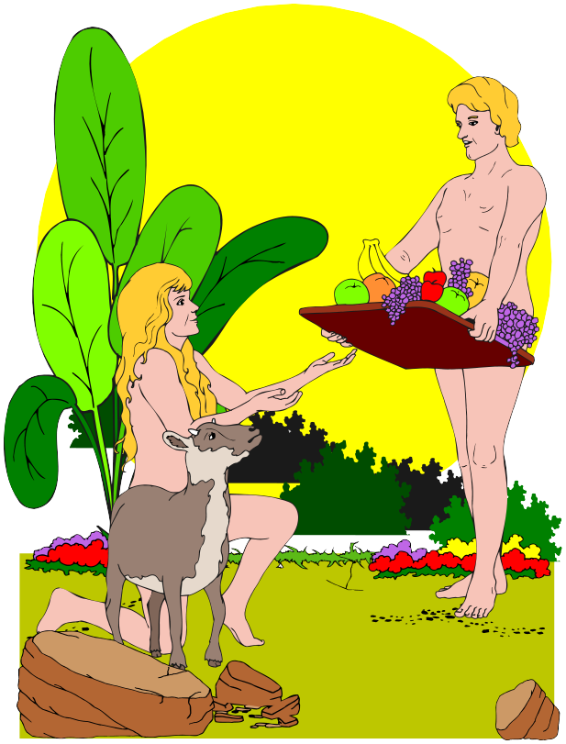
Mature Creation
Also called “ideal-time” view.
God creates in place Adam and mature plants and animals. Subsequent scientific inspection would see “appearance of age.”
Adam looks
20 years old.
plant looks
6 months old
grapes come
from a vine that
looks 5 years old
Logos Bible Clipart
Notes:
Logos Bible Clipart.
1
2
3

Slide 24
Age-Day Concordism
one “day”
1
2
3
4
5
6
a geological age
Notes:
1

Slide 25
Analogical Day
God works and rests
7
1
2
3
4
5
6
analogous
Man works and rests
1
2
3
4
5
6
7

Slide 26
Framework View
Also called pictorial day or moderate concordism.
God uses the sabbatical framework to organize and depict creative acts.
1: light; day/night
4: rulers of day/night
2: sea and air
5: rulers of sea and air
3: land
6: rulers of land
Notes:
1
2
3
4
5
6

Slide 27
I. Evaluation of
Age of the Earth

Slide 28
Evaluating 24-Hour Day View
24 hours
According to astronomy, light from distant galaxies requires millions of years to arrive here.
Hence the universe appears old.
Hence, 24-Hour Day View becomes the Mature Creation View.
YEC proposes “alternative astronomy.” But hard to see how this can work in detail.
How do you measure an hour?
Notes:
*

Slide 29
Evaluating Mature Creation
Logos Bible Clipart
Automatically harmonizes with modern science.
But is God playing fair? Is he deceiving us by dinosaur bones? (Dinosaurs never really existed, but are only an extrapolation backward in “ideal time.”)
Deception arises only when man goes by the (unfounded) assumption that he can indeed infer a real past by uniformitarian projection from present data.
Notes:
*

Slide 30
Evaluating Age-Day Concordism
geologic age
counterevidence:
Days are numbered.
They have an “evening” and “morning.”
Exod. 20:11 correlates the 6 days of creation with the 6/1 pattern of Israel’s weekly sabbath.
If Gen. 1 has an analogical or figurative use of time, the analogy belongs to the whole picture, not to the word “day.”
Hence, framework or analogical view.
Notes:
*
4

Slide 31
Evaluating the Framework View
1
4
2
5
Structure of week
Structure is there.
Structure may add to time order rather than being an alternative.
“Mere” framework suggests it is not serious; in fact, these are real events.
Time dimension is significant.
1
4
2
5
3
6
7
Notes:
*

Slide 32
Evaluating the Analogical View
model
God’s week
Exodus 20:10-11 indicates an analogy between God and man.
  God worked six days, rested on the seventh.
  man works six days, rests on the seventh.
1
4
2
5
3
6
7
model
man’s week (Exod. 20:11)
1
2
3
4
5
6
7
Notes:
1

Slide 33
Text for Analogy
model
“but the seventh day is a sabbath to the LORD your God; in it you shall not do any work, …
for in six days the LORD made heaven and earth, the sea, and all that is in them, and rested the seventh day; therefore the LORD blessed the sabbath day and hallowed it.” (Exod. 20:10-11)
עָשָׂה"make",
Notes:
1
2

Slide 34
God’s Rest
work in providence, redemption
creating
(finished)
God’s rest (= from creating)
(Gen 2:1)
consecrate time of God’s rest
(Gen 2:3)
“sabbath” = God’s rest
Man’s sabbath is analogous.
Notes:
God continues to work (providence, redemption).
God has finished creation: rest (Gen 2:1).
God’s rest is everlasting.
God’s seventh day, as consecrated for rest, is also everlasting.
Man’s seventh day is analogous not identical.
Whole week is analogous.
1
2
3
4
5

Slide 35
God’s Rest
God continues to work (providence, redemption).
God has finished creation: rest (Gen 2:1).
God’s rest is everlasting.
God’s seventh day, as consecrated for rest, is also everlasting.
Man’s seventh day is analogous not identical.
Whole week is analogous.

Slide 36
Possible Further Analogy
model
Genesis 1 says, “and there was evening, and there was morning” (1:5, 8, 13, 19, 23, 31).
From evening to morning is the night: “and at evening it [the cloud] was over the tabernacle like the appearance of fire until morning. So it was continually; the cloud covered it by day, and the appearance of fire by night. (Numbers 9:15-16)
Night is the time of man’s rest: Psalm 104:23.
Notes:
*

Slide 37
Resting
model
God pauses
at each evening
God rests
on sabbath
Permanent
rest
model
model
Man pauses
at each evening
Man rests
on sabbath
Temporary
rest
until consummation
Notes:
1
2
3

Slide 38
Evaluating the Analogical View
model
God’s week
God’s gardening (Gen. 1:11, 2:9)
God makes time measures (Gen. 1:14)
1
4
2
5
3
6
7
model
model
model
man’s week (Exod. 20:11)
man’s gardening (Gen. 2:15)
man counts periods (Lev. 23; 25)
1
2
3
4
5
6
7
Notes:
Tree from Microsoft Office Clipart Gallery.
1
2
3
4
5

Slide 39
Evidence for Analogical View
model
God’s days are a pattern for and analogous to ours, but not identical with ours.
  Heaven/earth analogy is familiar (Exod. 25-40).
  Man is made an earthly image of heavenly God.
  Man’s working is analogous to God’s working.
  7th day symbolizes consummation (eternal).
  7th day is analogical; so is the whole week.
  Trees now take years to grow to maturity.
  Man measures time through means provided on the fourth day: prevents measuring God’s days.
Notes:
**

Slide 40
Conclusion on Age of the Earth
24-Hour Day is theologically possible, and desires to be loyal to the Bible. Exegetically, it is weak, especially with the 7th day.
Mature Creation is possible and harmonizes with mainstream science.
Framework View is too vague.
Analogical View
  avoids exegetical overreading
  attends to 7th day
  notes foundation of the world in Divine action.
Notes:
**

Slide 41
J. Principal Christian Views of Biological Evolution

Slide 42
Fiat Production
God creates the distinct “kinds” of living things instantaneously. He uses pre-existing material (e.g., dust), but no other means.
God
instant of
creation
MSFT gallery
Notes:
Turtle from Microsoft Clipart Gallery.
1

Slide 43
Progressive Creationism
By special acts God creates distinct “kinds,” with acts of creation occurring at particular points along a long time scale.
God
create
amoeba
create frog
create mole
geologic ages
Notes:
1
2
3

Slide 44
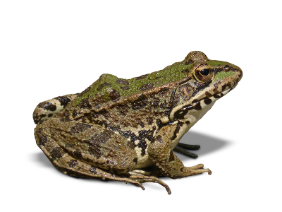

Theistic Evolution
God uses very gradual evolution as the means by which he makes (creates) the various kinds of living things.
God
supervises
entire process
means of
achieving
divine plan
evolution
CC0
CC0
Notes:
Fish: https://pixabay.com/en/trout-fish-rainbow-trout-animal-294469/. Public Domain.
Frog: https://pixabay.com/p-1445824/?no_redirect. Public Domain.
1
2

Slide 45
K. Evaluating Evolution

Slide 46
1. Relation between Biologic Evolution and Age of the Earth

Slide 47
Possible Old-Earth Views
theistic
evolution
age provides
time for evolution
old earth
acts of creation
spread over ages
More than
one option.
progressive
creationism
Notes:
1
2

Slide 48
Possible Young-Earth Views
rapid theistic
evolution
processes speeded
up, as in Gen. 2:9
young
earth
fiat
creationism
rapid-fire acts
lead to Adam
Notes:
1
2

Slide 49
2. Noah’s Flood
A complex issue, on which there is much disagreement.
Was the flood universal (whole globe)?
  Yes: massive miraculous action. A coherent scientific account is doubtful. Are we back to an ideal-time view?
  No: observable mountains could be covered with water in the form of snow. Then compatible with standard geology.
Notes:
**

Slide 50
3. Biblical Evidence on Evolution

Slide 51
Creation of Eve (Gen. 2:21-22)
“… while he was sleeping, he took one of the man’s ribs and closed up the place with flesh” (Gen. 2:21).
The Bible gives procedure (“how”), not just theological purpose (“why”). A rib.
Hence, it contradicts theistic evolution.
If events are supernatural here, no reason to withhold supernaturalism from other acts of creation in Gen. 1-2.
Science doesn't
dogmatize.
Notes:
*

Slide 52
Creation of Plants and Animals
No mention of means (secondary causes such as evolution)
But silence is not evidence that there were no means.
  Genesis focuses on God. No need to discuss the means.
  Means may be omitted (Ps. 104:14) or mentioned only in another place (Exod. 15:4, 8, compared with Exod. 14:21).
Notes:
**

Slide 53
Fixity of Kinds?
Does reproduction “according to kinds” imply absolute fixity of kinds (thus, no evolution)?
God guarantees to Israelites that breeding sheep leads to more sheep, and doves to more doves. He is the author of this order of things.
Genesis does not offer a scientific, technical comment about what might in theory happen in the course of millions of years of reproduction.
Notes:
*

Slide 54
Summary of Biblical Evidence
Eve is a special creation by God.
The Bible does not say whether God used means in creating kinds of plants and animals.
Go look at general revelation to learn details about means.
Notes:
*

Slide 55
4. Scientific Evidence
Regarding Evolution

Slide 56
Mainstream Science
The mainstream claims massive cohesive evidence from many subdisciplines:
Paleontology: fossil progression
Geographical distribution
Physiological similarities
Embryology
Molecular biology
Current occurrence of variation, mutation, and survival of favorable adaptations
Looks
impressive.
Notes:
*

Slide 57
Problems with the Mainstream
Anomalies. Anomalies in each specialty are held at bay by appealing to the “clear” conclusions of all the other specialties. (See Denton.)
Circularities. Evolution “explains” anything and therefore explains nothing in particular.
Assumption: Presupposition bridges gaps.
Lack of alternatives. No good alterative except supernatural creation, which science cannot investigate with its tools.
Use Van Til to watch those presuppositions!
Notes:
*

Slide 58
Problems with Materialism
Gaps in fossil record
No plausible source for new information
Experimentation: fixity of kinds
Not enough time!
Notes:
*

Slide 59
Resources
Poythress, Redeeming Science (Crossway)
discovery.org/id/
Notes:
*

